Slide 1
RSA
BESE-14
Ijaz Ahmad

Slide 2
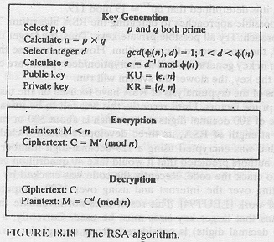
RSA Public Key Encryption Algorithm
The best known public key cryptosystem is RSA - named after its authors, Rivest, Shamir and Adelman

Slide 3
Public-Key Cryptography
Public-key (or two-key) cryptography involves the use of two keys:
  A public-key, which may be known by anybody, and can be used to encrypt messages, and verify signatures
  A private-key, known only to the recipient, used to decrypt messages, and sign (create) signatures

Slide 4
Alice, Bob and Trudy
In a Public Key system when Alice sends email to Bob, she finds his public key (possibly in a directory of some sort) and encrypts her message using that key. Unlike secret-key cryptography, though, the key used to encrypt will not decrypt the ciphertext. Knowledge of Bob’s public key will not help an eavesdropper. To decrypt, Bob uses his private key. If Bob wants to respond to Alice, he will encrypt his message using her public key.
Trudy (from Intruder) tries to disrupt the communication between Alice and Bob

Slide 5
Public-Key Cryptography Requirements
The public-key is easily computed from the private key and other information about the cipher
However, knowing the public-key and public description of the cipher, it is still computationally infeasible to compute the private key
Thus the public-key may be distributed to anyone wishing to communicate securely with its owner

Slide 6
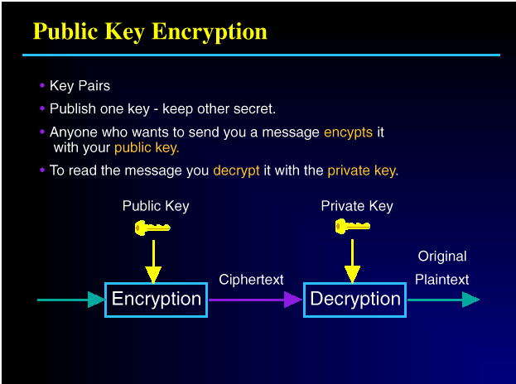

Slide 7
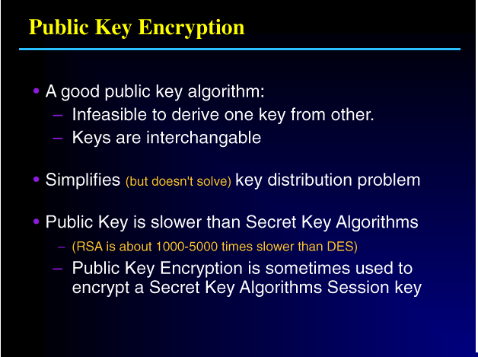

Slide 8
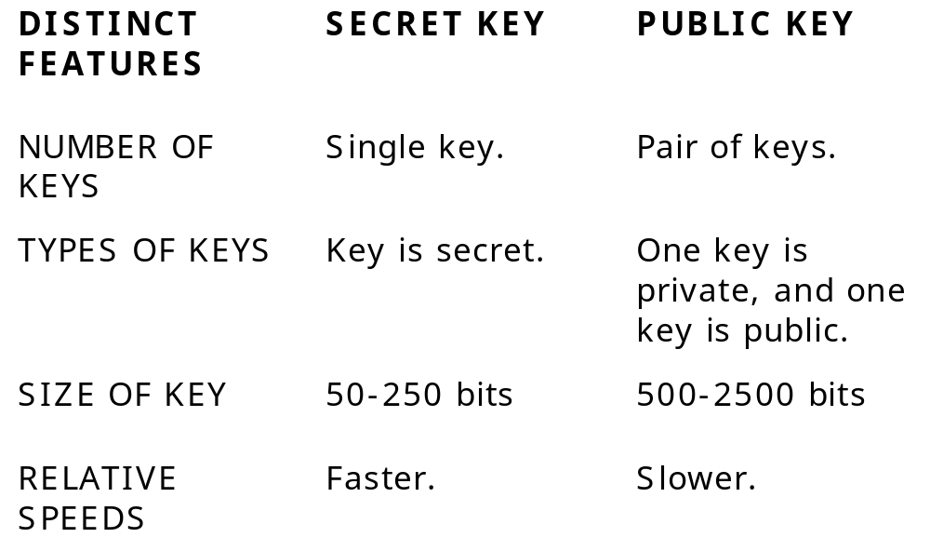
Comparison of SK and PK

Slide 9
Multiplication is a Mathematical Trapdoor
It turns out that multiplication can be a one-way function.
In general it is easy (especially on computers) to multiply two big prime numbers.
But for most very large numbers, it is extremely time-consuming to factor them.

Slide 10
Math Behind RSA
RSA is a public-key cryptosystem that MIT professors Ronald L. Rivest, Adi Shamir and Leonard M. Adleman invented in 1977. The system is based on several mathematical principles in number theory.

Slide 11
Prime Numbers ...
A prime number, or prime, is a number that is evenly divisible by only 1 and itself.
For instance 10 is not prime because it is evenly divisible by 1, 2, 5 and 10. But 11 is prime, since only 1 and 11 evenly divide it.
The numbers that evenly divide another number are called factors. The process of finding the factors of a number is called factoring.

Slide 12
Factoring a Number ...
For example, factoring 15 is simple, it is 3 * 5. But what about 6,320,491,217?
Now how about a 155-digit number? Or 200 digits or more? In short, factoring numbers takes a certain number of steps, and the number of steps increases subexponentially as the size of the number increases. That means even on supercomputers, if a number is sufficiently large, the time to execute all the steps to factor it would be so great that it could take years to compute.

Slide 13
Modular Arithmetic
a = b mod (m) means that when a is divided by m the remainder is b.
Examples
11 = 1 mod (5)
20 = 2 mod (6)

Slide 14
Modular Math and Prime Numbers
Prime numbers possess various useful properties when used in modular math.
The RSA algorithm takes advantage of these properties.

Slide 15
Modular Inverse
Another aspect of modular math is the concept of a modular inverse.
Two numbers are the modular inverses of each other if their product equals 1.
For instance, 7 * 343 = 2401, but if our modulus is 2400, the result is:
(7 * 343) mod 2400 = 2401 – 2400 = 1 mod 2400

Slide 16
Relatively Prime
Two numbers are relatively prime if they share only one factor, namely 1.
For example, 10 and 21 are relatively prime. Neither is prime, but the numbers that evenly divide 10 are 1, 2, 5 and 10, whereas the numbers that evenly divide 21 are 1, 3, 7 and 21.
The only number in both lists is 1, so the numbers are relatively prime.

Slide 17
Euler’s phi-function
In the eighteenth century, the mathematician Leonhard Euler (pronounced "Oiler") described ϕ(n) as the number of numbers less than n that are relatively prime to n. The character ϕ is the Greek letter "phi". This is known as Euler’s phi-function.

Slide 18
Euler’s phi-function
So ϕ(6), for instance, is 2, since of all the numbers less than 6 (1, 2, 3, 4 and 5), only two of them (1 and 5) are relatively prime with 6. The numbers 2 and 4 share with 6 a common factor other than 1, namely 2. And 3 and 6 share 3 as a common factor.
What about ϕ(7)? Because 7 is prime, its only factors are 1 and 7. Hence, any number less than 7 can share with 7 only 1 as a common factor. Without even examining those numbers less than 7, we know they are all relatively prime with 7. Since there are 6 numbers less than 7, ϕ(7) = 6. Clearly this result will extend to all prime numbers. Namely, if p is prime, ϕ(p) = (p ‑ 1).

Slide 19
Exponentiation
Exponentiation is taking numbers to powers, such as 2³, which is 2 * 2 * 2 = 8. In this example, 2 is known as the base and 3 is the exponent. There are some useful algebraic identities in exponentiation.
(b^{x}) * (b^{y}) = b^{x+y}
(b^{x})^{y} = b^{xy}

Slide 20
Exponential Period modulo n
Euler noticed that ϕ(n) was the "exponential period" modulo n for numbers relatively prime with n.
What that means is that for any number a < n, if a is relatively prime with n, a ^{ϕ(n)} mod n = 1.
So if you multiply a by itself ϕ(n) times, modulo n, the result is 1. Then if you multiply by a one more time, you are finding the product of 1 * a which is a, so you are starting over again.
Hence, a ^{ϕ(n)} *a = a ^{ϕ(n)+1} mod n = a.

Slide 21
Exponential Period modulo n
For example, if n is 5 (a prime number), then ϕ(5) = 4. Let a be 3 and compute
a ^{ϕ(n)} mod n = 3⁴ = 3 * 3 * 3 * 3 mod 5

Slide 22
Coming to RSA ...
We find two large primes, p and q, and use their product
    n = pq
as the modulus. We still choose a public exponent, e, and using the extended Euclidian algorithm find d, the inverse of e modulo ϕ(n). This time, however, we are finding the d that satisfies
    e * d = 1 mod (p ‑ 1)(q ‑ 1)
The pair (n, e) is the public key and d is the private key. The primes p and q must be kept secret or destroyed.

Slide 23
Coming to RSA ...
To compute ciphertext c from a plaintext message m, find
    c = m^{e} mod n
To recover the original message, compute
    m = c^{d} mod n
Only the entity that knows d can decrypt.
Because of the relationship between d and e, the algorithm correctly recovers the original message m, since
    c^{d} mod n = (m^{e})^{d} = m^{ed} = m¹ = m mod n

Slide 24
Coming to RSA ...
Anyone else who wants to compute d, must first know ϕ(n), but to know ϕ(n) one must know p and q. In other words, they must factor n. Remember the one-way function? We knew that multiplying big prime numbers can be a one-way function, we simply needed to figure out a way to use that fact.
Here it is, build the private key using two primes and the public key using their product.

Slide 25
Coming to RSA ...
There is one more condition, the public exponent e must be relatively prime with (p ‑ 1)(q ‑ 1). That is because if e is not relatively prime with (p ‑ 1)(q ‑ 1), there will be no modular inverse.
Incidentally, in practice you would generally pick e, the public exponent first, then find the primes p and q such that e is relatively prime with (p ‑ 1)(q ‑ 1). There is no mathematical requirement to do so, it simply makes key pair generation a little easier.
In fact, the two most popular e‘s in use today are F0 = 3 and F4 = 65,537. The F in F0 and F4 stands for Pierre de Fermat, the 17th century mathematician who first described the special properties of these and other interesting numbers.

Slide 26
RSA Algorithm
First choose two large prime numbers, p and q, and find their product, n. n is also called modulus in RSA jargon.
Compute z = (p-1)(q-1)
Next choose a number e, relatively prime to z = (p-1)(q-1) - this is the encryption key.
Finally compute d such that the product of e and d is congruent to 1 mod ((p-1)(q-1)). This is the decryption key.

Slide 27
RSA Algorithm
Obviously, d can only be recovered if you reveal p and q, or if p and q are recovered from n, the modulus. Since we are assuming the factorization of n to be too hard to attempt, d cannot be recovered from e. Or so it is currently speculated. It has not, so far, been proven.
Now e and n together form the public key, while d and n together form the private key.

Slide 28
RSA Key Generation
To use the scheme, first generate keys:
  Key-Generation by each user consists of:
  selecting two large primes at random (~100 digit), p, q
  calculating the system modulus n=p.q and p, q are primes
  selecting at random the encryption key e,
  e < n, gcd(e, φ(n)) = 1

Slide 29
RSA Key Generation (cont’d)
Solving the congruence to find the decryption key d:
  e.d ≡ 1 mod φ(n) 0 <= d <= n
Publishing the public encryption key: Kpub={e,n}
Securing the private decryption key: Kpvt={d,p,q}

Slide 30
Encryption with RSA
To encrypt a plaintext message block m, compute
  C=Me mod n
To decrypt the block, compute
  M=C^{d} mod n
Each plaintext block must be smaller than the value of n.

Slide 31
RSA Algorithm

Slide 32
RSA Example
p = 3
q = 11
n = p X q = 33 -- This is the modulus
z = (p-1) X (q -1) = 20 -- This is the totient function φ(n). There are 20 relative primes to 33. What are they? 1, 2, 4, 5, 7, 8, 10, 13, 14, 16, 17, 19, 20, 23, 25, 26, 28, 29, 31, 32
d = 7 -- 7 and 20 have no common factors but 1
7e = 1 mod 20
e = 3
C = P^{e} (mod n)
P = C^{d} (mod n)

Slide 33
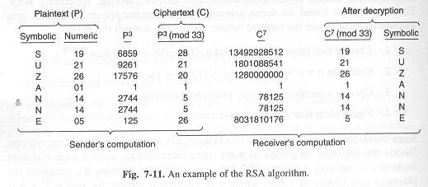
RSA Example

Slide 34
Digital Signatures Using RSA
Generally D_{KPvt}(E_{KPub}(P))=P
RSA also has the property D_{KPub} (E_{KPvt} (P))=P
Since the text can also be encrypted with K_{Pvt} and decrypted with K_{Pub}, it is possible to use RSA for signatures, where a block of data is encrypted with the private key, and can be decrypted with the public key to show that the sender truly did sign/send that data him/herself.

Slide 35
Digital Signatures
However, simply using the encryption of a plaintext document using the private key is not only inefficient (producing a much-too-large signature) but also insecure. Bruce Schneier describes a possible attack in this situation in Applied Cryptography. It is important to use a one-way hash function before signing a document.

Slide 36
RSA Summary
RSA (Rivest-Shamir-Adelman) is the most commonly used public key algorithm.
Can be used both for encryption and for digitally signing.
It is generally considered to be secure when sufficiently long keys are used (512 bits is insecure, 768 bits is moderately secure, and 1024 bits is good, for now).
The security of RSA relies on the difficulty of factoring large integers. Dramatic advances in factoring large integers would make RSA vulnerable.
RSA is currently the most important public key algorithm. It is patented in the United States (expires year 2000), and free elsewhere.

Slide 37
RSA Weaknesses
At present, 512 bit keys are considered weak, 1024 bit keys are probably secure enough for most purposes, and 2048 bit keys are likely to remain secure for decades.
One should know that RSA is very vulnerable to chosen plaintext attacks. There is also a new timing attack that can be used to break many implementations of RSA. The RSA algorithm is believed to be safe when used properly, but one must be very careful when using it to avoid these attacks.

Slide 38
The Previous History of Factoring
The security of the RSA cryptosystem therefore depends on the fact, that it is practically impossible to factor the large known modulus n. So nobody can infer the two primes p and q from his or her knowledge of the publicly known modulus to gain the secret key.
70-digit numbers will be factored today (1998) on a workstation within 10 hours.
100-digit numbers will be factored on a workstation within 1 year.

Slide 39
The Previous History of Factoring
129-digit numbers :
  In August 1977 Martin Gardner asked the readers of Scientific American to factor
  114 381 625 757 888 867 669 235 779 967 146 612 010 218 296 721 242 362 562 561 842 935 706 935 245 733 897 830 597 123 563 958 705 058 989 075 147 599 290 026 879 543 541 .
  Some 16 years later, in April 1994 the factors were presented by Paul Leyland (University of Oxford), Michael Graff (University of Iowa) and Derek Atkins (MIT). They had been supported by over 600 volunteers running a computerprogram written by K. Lenstra (Bell Labs, Morristown, New Jersey) on their workstations at night sharing the work of factoring over the internet.

Slide 40
The Previous History of Factoring
140-digit numbers are the smallest numbers not having been factored in 1996.
  They will be factored within about 5 years using large-scale networking.
160-digit numbers:
  In 1996 experts expect factoring to be possible within about 5 years using a new method of factoring known as number field sieve.
200-digit numbers:
  The time for factoring is estimated at 52 000 000 years in 1998

Slide 41
How Large Should the Primes be?
The two primes, p and q, which compose the modulus, should be of roughly equal length; this will make the modulus harder to factor than if one of the primes was very small. Thus if one chooses to use a 768-bit modulus, the primes should each have length approximately 384 bits. If the two primes are extremely close (identical except for, say, 100 - 200 bits), there is a potential security risk, but the probability that two randomly chosen primes are so close is negligible.

